Slide 1
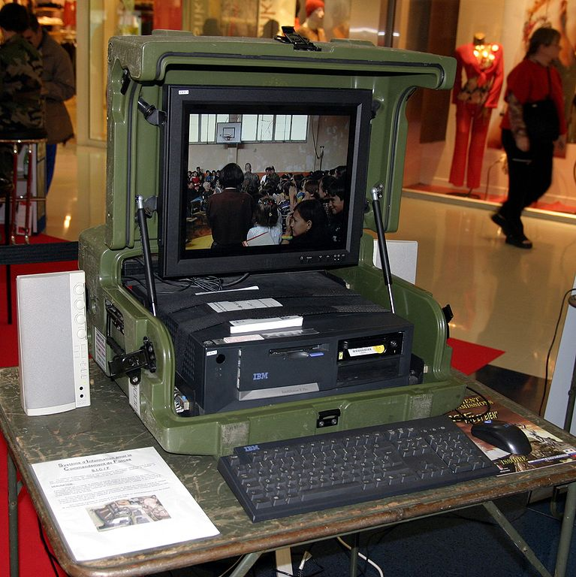
Mobile and Desktop Applications with C♯
Rasmus Lystrøm
Associate Professor
ITU
This Photo by Unknown Author is licensed under CC BY-SA

Slide 2


Guest Lecture
Ali Reza Farahnak
Global Senior Customer Engineer
Mobile Application Development with C♯
This Photo by Unknown Author is licensed under CC BY

Slide 3

Agenda
Mobile and Desktop Applications (by Ali)
MVVM Architectural Pattern
Xamarin.Forms
.NET Multi-platform App UI (MAUI)
Upgrading .NET applications
C♯ 10
Blazor follow-up
Windows Applications
Windows Forms (WinForms)
Windows Presentation Foundation (WPF)
This Photo by Unknown Author is licensed under CC BY-NC-ND

Slide 4
Upgrading .NET Applications

Slide 5
The Tools
dotnet tool install --global upgrade-assistant
dotnet tool install --global try-convert
upgrade-assistant analyze <csproj/sln>
upgrade-assistant upgrade <csproj/sln> --skip-backup

Slide 6
Update your stack
Get the latest .NET SDK: https://dot.net/
dotnet tool list --global
dotnet tool update --global dotnet-ef
dotnet list package --outdated

Slide 7
Update your .csproj files
<Project Sdk="Microsoft.NET.Sdk">
<PropertyGroup>
<TargetFramework>net6.0</TargetFramework>
<Nullable>enable</Nullable>
<ImplicitUsings>enable</ImplicitUsings>
</PropertyGroup>
</Project>

Slide 8
Upgrading .NET Applications
Demo

Slide 9
C♯ 10 / .NET 6.0

Slide 10
Important new features
Global using directives
Implicit using directives
Implicit Program.Main
File-scoped namespace declaration
Nullable reference types from C♯ 8 are now default

Slide 11
C♯ 10 / .NET 6.0
Demo

Slide 12
Thank You

